Slide 1
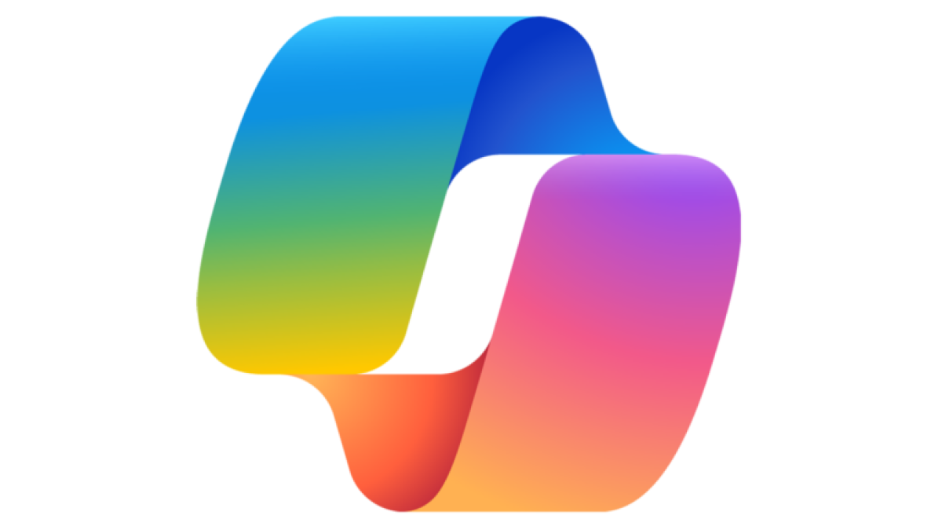















Keeping Up
Without
Burning Out
Kourtney Meiss
Developer Evangelist
Notes:
Quick show of hands. Is anyone feeling behind with AI right now?
Ok I’m in good company because I feel the same way and one piece of my role is to drive AI adoption at Amazon
AI has been really overwhelming over the last year.
I have this constant feeling of being behind.
But "feeling behind" isn’t really naming the thing that it turns into, which is where I want to start…

Slide 2

Stress vs Burnout
Notes:
and that’s burnout
burnout isn't just being tired. Tired, you fix with a weekend.
Burnout is when the thing you used to be excited about starts to feel like a threat.
When a new tool launch is one more reason to feel inadequate, instead of one more cool thing to try.
When you're running as fast as you can just to stay in place — quietly exhausted by a field you used to love.
And here's the part nobody warned us about. AI lets us get more done than ever — I can ship in a day what used to take me a week.
But that's exactly the problem. The old limits are gone. You used to hit a natural stopping point — the work was done, or you were
out of hours, or you just couldn't do any more. AI removed the ceiling. So the only limit left is you. How much can you take on?
And the answer keeps being "a little more." A little more, a little more — until "more done than ever" quietly becomes "never
actually done.” The finish line keeps moving.
That's the fast path to burnout. Doing more than you were ever meant to — because nothing's stopping you.
In devrel we’re more susceptible to this than others because we’re often the jack of all trades, constantly context switching,

Slide 3
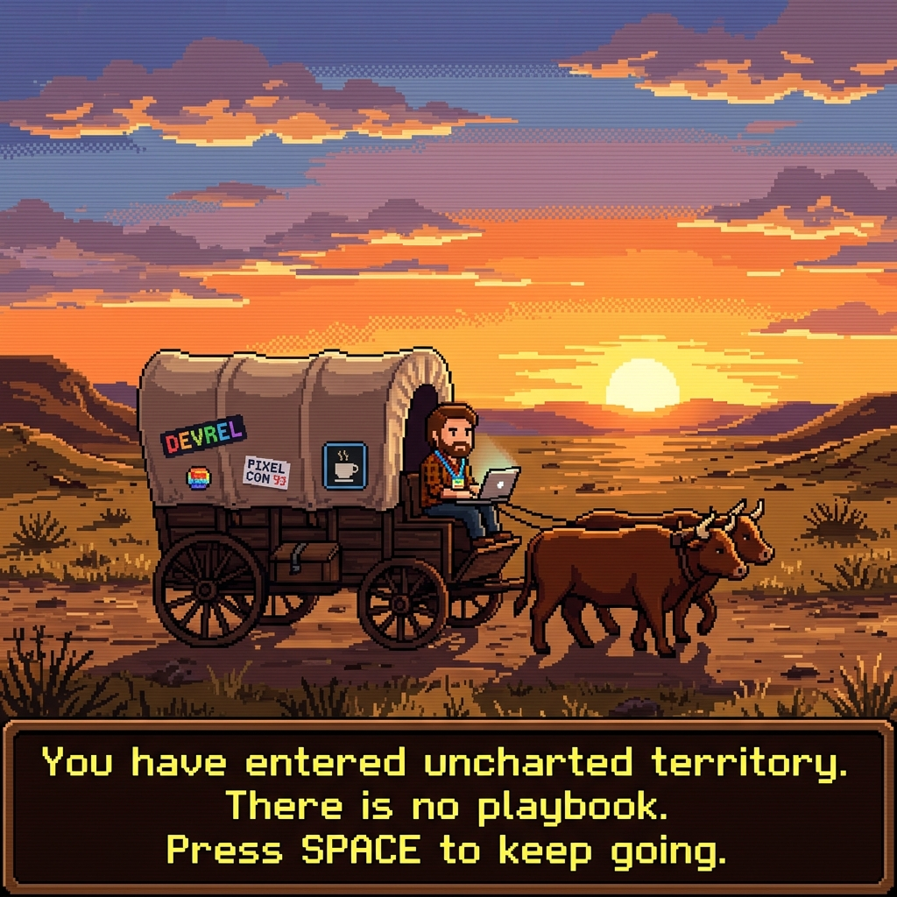
Notes:
One of the reasons we might feel this way isn't that we're bad at our jobs.
It's that we're out here in uncharted territory, without a map. (gesture at wagon)
Nobody's written the guide for how to use AI in DevRel most effectively, at our specific companies, in our real workflows.
So if it feels like you're making it up as you go — you are. We all are. That's not a gap in your knowledge. That's the frontier.
And I won't pretend that isn't hard sometimes but that's the same reason it’s the a really exciting time to be doing this work.
As much as I'd love to stand up here and hand you a complete playbook — I can’t. I don't have all the answers yet either.
What I can do is show you what's worked for me so far, and give you a path you can actually start from if you’re feeling lost or behind.

Slide 4

Notes:
Let me take you back to where things actually started clicking for me.
It all starts with Pokopia.
If you've played it, you know how addicting it is— if you haven't, all you need to know is you get to play with over 300 Pokémon, each with their own specialties that you need as you play.
Needless to say, It was becoming the way I’d unwind after work, - a tool to help me combat burnout if you will.
And around this same time, I was hitting a wall with AI. My prompting had gotten pretty good, I had a couple of agents running — but I wasn’t clear on how to level up.
I had had feeling the next level was hiding behind a term I kept hearing everywhere and didn't really understand: agent orchestration.
I went and did the obvious thing first. I read everything I could about it, but it was still hard to wrap my brain around.
I wanted to figure out how to use it in my own day-to-day.
So I set off to build my own personal orchestration.

Slide 5







Hub and Spoke Multi-Agent Orchestration
Personal
Assistant
Research
Orchestrator
Other
Validator
Content
Repurpose
Notes:
And here's where the two worlds collided.
Remember, I was completely obsessed with Pokopia at the time.
So when it came time to name these agents… "Agent 1, Agent 2" felt boring.
So I had a fun afternoon picking the perfect Pokémon to fit each job.
And if you’re curious about the reasoning behind each I’ll link a blogpost at the end where I dive into it.
I kept it simple, one orchestrator, a couple of subagents for the most common things I was using AI for.
And here’s the first version of the system I landed on:
My orchestrator was metagross – whos only job is to route tasks, never execute directly
Indeedee as my personal assistant with access to my email, calendar, ticketing system, and slack.
Alakazam as my researcher
Slowpoke as my information validator
Ditto as my content writer and repurposer
And Mew as my catch all for any tasks that didn’t fit another subagent.
And here's the thing — by the time I was done? I actually understood orchestration. Not "I read a blog post" understood. Deep enough to explain it from scratch to someone who was only picturing this when they hear orchestration:
CLICK FOR PICTURE
Orchestration is abstract. It's hard to teach. You don't need to know Pokémon to get this.
At the core it’s a team of specialists — each one does one thing well and they work together. That's a concept every developer already knows.
The thing that made it fun also handed me the way to teach it.
And isn't that the whole job in DevRel? Taking something hard and connecting it to what people already understand.

Slide 6
High curiosity = core state of play
Increased memory retention by 30%
UC Davis Center of Neuroscience
Notes:
I think it’s worth pausing to mention real science under this, too
Neuroscientists at the UC Davis Center for Neuroscience found that:
when we approach a task with high curiosity—a core state of play—the brain's reward center lights up.
This neurological shift increases our memory retention by roughly 30% compared to dry, rote learning.
So this makes our goal – how can we be in a state of play when learning this new AI stuff.
https://www.scientificamerican.com/article/curiosity-prepares-the-brain-for-better-learning/

Slide 7

Encountering Issues
Me
Personal
Assistant
Research
Orchestrator
Other
Validator
Content
Repurpose
Notes:
I was heavily using my new system every day and uncovering isssues as I went.
For example: I observed that data didn’t look correct , My research agent would come back with an answer that sounded confident and complete — but I had no idea if it was actually right without diving into the data myself, which is exactly what I was trying to avoid by using AI in the first place. And a confident wrong answer is worse than no answer. Now, I already had a validator agent. But the problem was it only ran when I remembered to ask for it.
Example: 1000 survey respondents -→ 1500 actual respondents and if I didn’t tell it to validate that number, the wrong value was used.
User prompts orchestrator → Delegate to research subagent → Answer returned to orchestrator → Orchestrator gives results to user
User prompts orchestrator → Delegate to validation subagent → Answer returned to orchestrator → Orchestrator gives results to user

Slide 8
Constructive Tension
Me
Personal
Assistant
Research
Orchestrator
Other
Validator
Content
Repurpose
Notes:
I added a rule: research never comes back to me directly. It always gets validated first.
I call it constructive tension. One agent creates, the others job is to challenge it.
I made that hand-off automatic, not optional. The friction between them is what makes the output trustworthy.

Slide 9
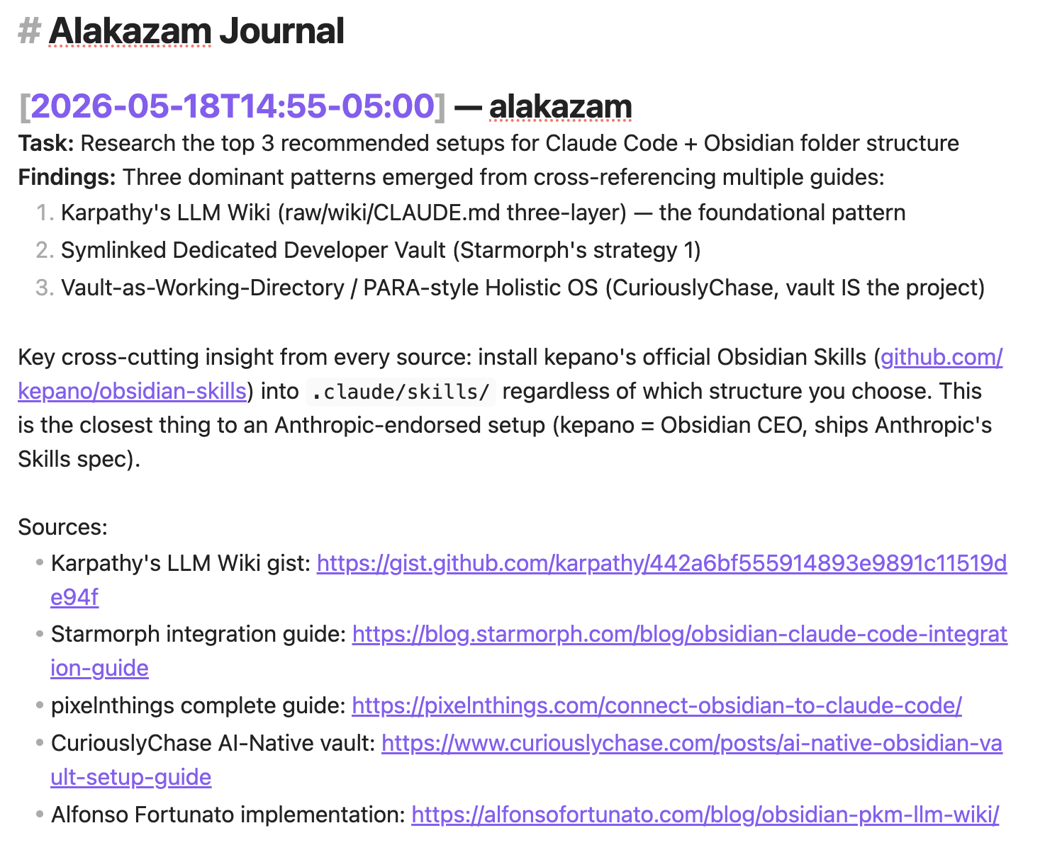
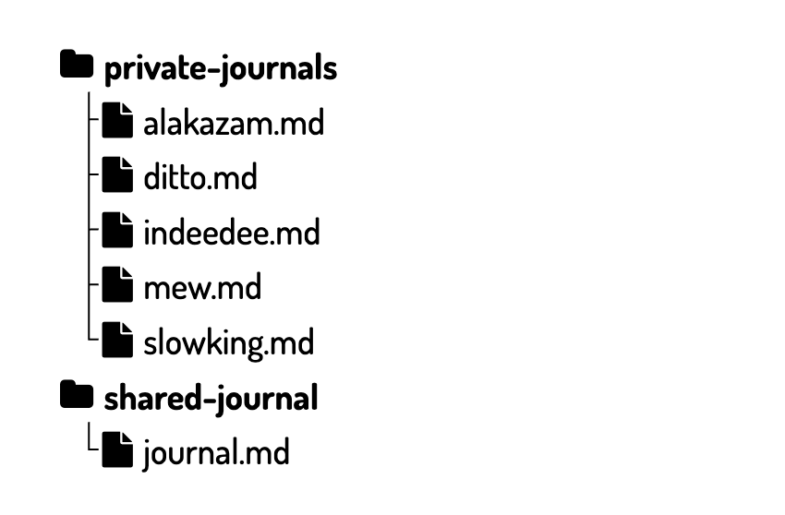


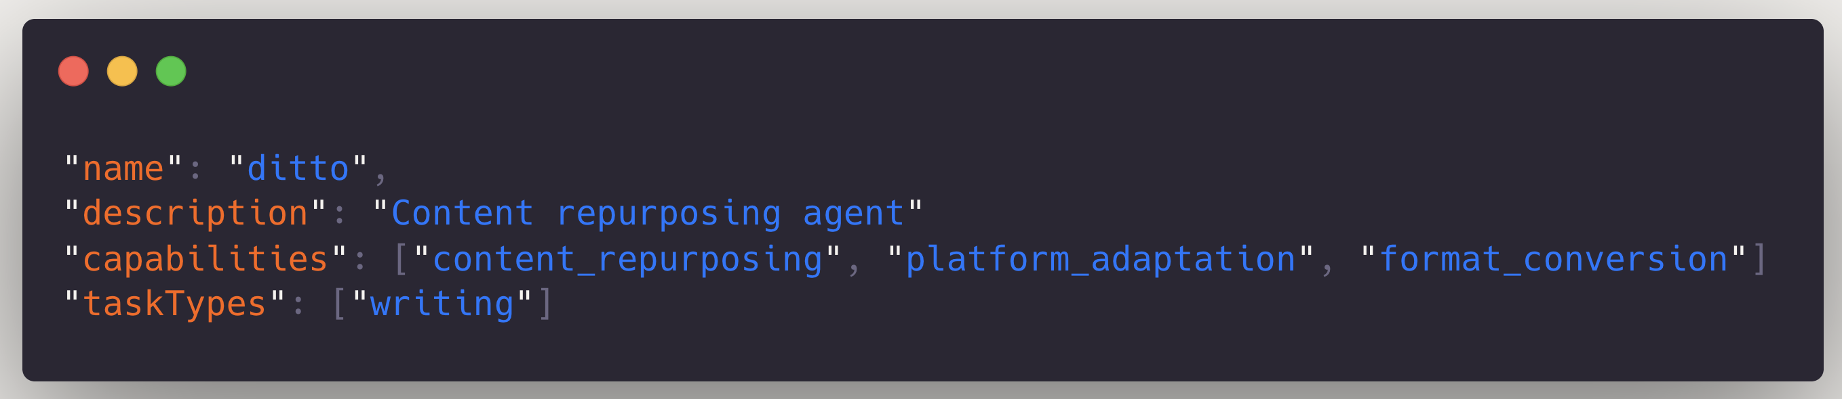
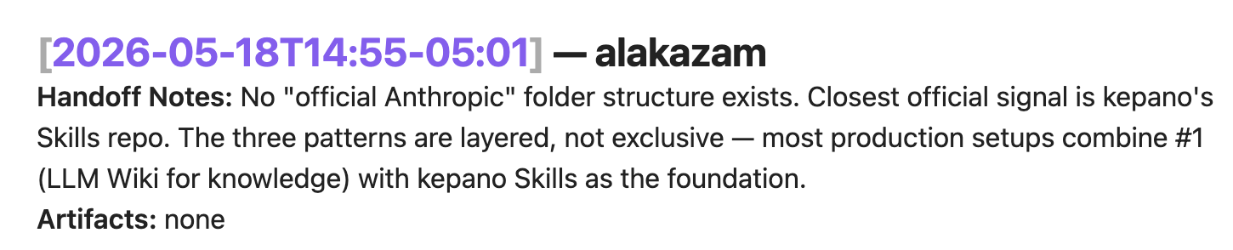
System Upgrades
Shared Journal
Registry + Test Harness
the orchestrator wasn’t always reliably routing tasks to correct agent
agents lost context between sessions without persistent memory
Notes:
The more I used this system everyday the move improvement I thought of or needed to make.
First, routing got fuzzy. The orchestrator wasn’t reliably delegating to the right agent.
It couldn’t tell which agent should handle what especially if the line was blurry — so I gave it a registry: a simple json list of what each agent is actually good at.
Now the orchestrator had something to route against.
But how could I test it? That’s when I learned about harnesses. There's different types but A test harness lets you test this plumbing – does the right agent get called for the right task.
----
Next, agents kept losing context. One would finish, the next would start from nothing. So I gave them a shared journal — one agent writes down what it found, the next one reads it before it starts. That's the handoff.
And I kept the messy stuff separate. Each agent also has a private journal for its own scratch work — dead ends, half-finished thinking — the stuff nobody else needs to see.

Slide 10
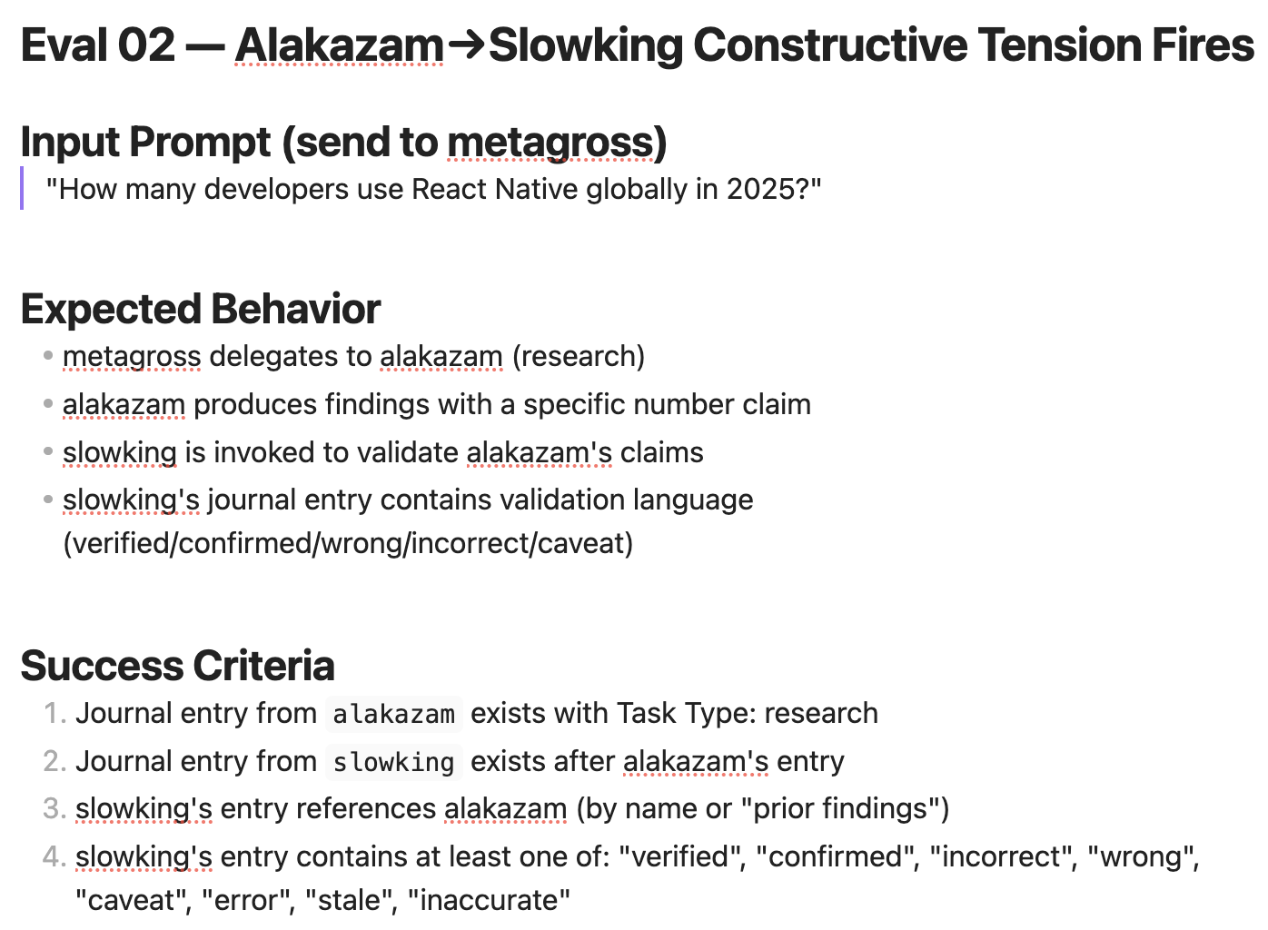


System Upgrades
Queryable Journal
Evals
journal became massive and took up too much context
couldn’t tell if the output was good
Notes:
"Reading the whole shared journal before every task got expensive, it was taking up my context window before I even started, — so instead of 'read everything,’ agents learned to ask a question first. Same journal, but now it's a lookup”
"have we previously researched folder structure setups for claude and obsidian"
--
But my biggest issue with AI was still trust. How could I trust that the output was good. The system ran, it routed — but was the research quality? And that’s when I learned about evals.
I did what any engineer does when they don't trust their own system: I wrote tests for it. Not tests for a function — tests for behavior. Did the validator actually catch the mistake, or did it just nod along? Evals ways to actually measure the quality, not just the plumbing.
If alakazam says React Native had 10,000 users in 2025, slowking takes that number and goes and verifies it — fetching the actual sources to check whether the claim holds up.

Slide 11
Build it when it breaks. Not before.
Notes:
Here's the pattern under all of it. I never built anything until something broke or I could identify a meaningful improvement. Every single piece
— the registry, the journals, the evals — existed because I felt the pain it was solving first.
This is the part you can't skip.
I only understood orchestration deeply because I hit every wall myself. The pain wasn't the obstacle — it was the mechanism.

Slide 12
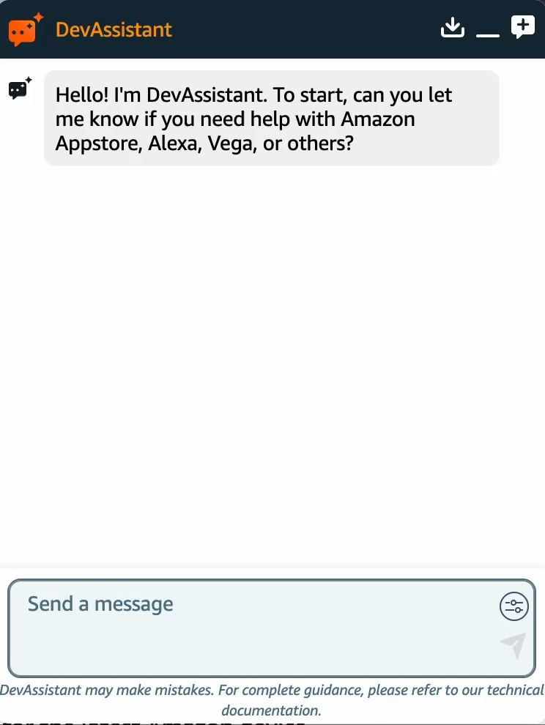
RAG vs Agentic
1
Poor response quality
2
Lack of extensibility
3
Inability to integrate with latest tech
Notes:
Now — you could look at everything I just showed you and think: cute at small personal scale, but I can’t just have fun in production systems.
I want to introduce you to DevAssistant.
It's Amazon's chatbot for our developer docs —its live and developers use it every day to get answers.
And it started as a RAG system. If you haven't run into RAG — it's basically "go retrieve the relevant docs, then answer based on them." Retrieve, then respond. It's the obvious first move. And it works — right up until it doesn't.
Because they hit a wall just like I did:
QUALITY: We have APIs with multiple versions. When a developer asks about an API, all five versions surface as top results because the name matches exactly. The model can't distinguish between them and hallucinates the differences.
EXTENSIBILITY: Every new feature we wanted to add — support case lookup, account context, personalization — meant rewriting orchestration code. The architecture fought us every time.
INTEGRATION: New protocols and standards emerged, like MCP and A2A. We couldn't adopt them without gutting the entire orchestration layer.
So what did they do? They didn't start over. They added the next piece. They evolved it into agentic orchestration — agents and tools, a system that could do more than retrieve-and-answer.
And that's the exact same road I walked with my Pokémon. Start simple. Hit the wall. Improve.
Fun wasn't the detour — it was the mechanism. I played my way into understanding a production system.
The pattern I want you to take away maps directly to the framework I'll show you next — Crawl, Walk, Run.
----
"Here's the difference between my Pokémon system and Dev Assistant. Same path — crawl, walk, run. But
on a personal system, I'm the safety net. If something's wrong, I catch it. On a production system,
shipping to thousands of developers? You can't personally check every answer. The system has to check
itself. That's why evals aren't optional up here — the higher the stakes, the less you can afford to
trust something just because it looks right."

Slide 13

Playbook
2nd Evolution
3rd Evolution
1st Evolution
LLM Basics
Prompting
Tokens
Context Window
MCPs
Agents
Skills
Orchestration
Evals
Harnesses
Notes:
Back at the start, I told you I didn't have the finished playbook ..
If I were starting from scratch today, here’s the order of learning I would use:
FIRST— get fluent with the model itself. Just chatting. Prompting, iterating, watching how it responds.
What’s happening behind the scenes when you ask something – the probability calculations at play.
Learn what context does — why what you feed it changes everything you get back. And what tokens are and how they work.
This is the stage everyone wants to skip. Don’t. This is what gave me a solid foundation to build on.
SECOND — make it work for you, repeatably. Create agents, make/add skills, connect to your real tools and data.
The shift is going from "I ask, it answers" to "I've set it up to do a job for me, with all the information it needs.”
THIRD — systems that coordinate and check themselves.
Orchestration — multiple agents together. Add evals and harnesses — knowing whether the output is actually good, not just whether it ran.
The skill here isn't building more. It's trusting a system because you can measure it, not because it looks right.
(beat — shift)
But here's the thing this slide doesn't show you. It's a list of what to learn. It's not how well you do it.
You can understand what an agent is in an afternoon. Building a good one — knowing what to give it, what to hold back, when not to use one at all
That takes reps and hitting walls. Every box up here has a shallow version and a deep version, and the depth is the whole game.
That's what my Pokémon system actually taught me. Not what orchestration is — the best practices.
And I only know them because I built the bad version of each one first.
And that's the part no playbook can give you.
(beat)
And is there stuff past 3rd evolution? Sure. Fully autonomous systems, ones that improve themselves. That's the
frontier — and honestly, most of us, me included, aren’t quite there yet. And that’s going to keep changing quickly
People burn out because they sprint straight to 3rd evolution because that’s the latest and greatest before they’ve laid the foundation. Start where you are. Add
the next thing when you hit the wall the current one can't solve.
That's not falling behind. That’s you keep up without drowning.

Slide 14


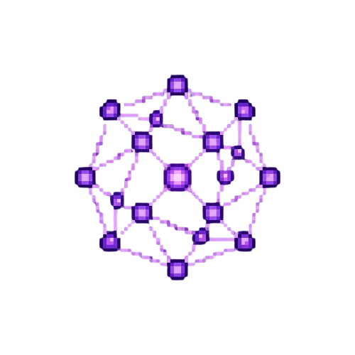

Wispr Flow
Voice Dictation
Claude Code
Agent
Obsidian
Memory
Read/Write
Bee
Ambient Context
Notes:
So that's how I approach learn. This is how I actually work, day to day.
And I want to be honest about what's on this slide, because it's probably simpler than you'd expect. Four tools.
That's it. I'm not running some sprawling stack of the latest thing every week.
Here's how they fit together. (gesture at the flow) Everything points at Claude Code in the middle — that's the engine, that's what actually does the heavy lifting. It’s the coding agent Amazon provides access to, but this you could swap this with whatever you use.
And then these other three tools are all about context. Your output from LLMs is only as good as the context you provide and some of the best context comes from small conversations you’d otherwise lose.
I dictate to it using Wispr flow – not only am I able to talk faster than I can type but I also provide a lot more context.
Bee is an Amazon AI wearable that captures ambient context – so if I’m at at booth or in a meeting I’ll be able to ask Claude questions about it.
And then Obsidian lets me store files locally as markdown so claude can read/write them.
When we get to the Q&A I’d also love to hear if there’s anything I’m not using here you love
------
I don't try to drink from the firehose. I follow a small list of people who help me keep up. Keeping up isn't a consumption problem — it's a curation problem.
I block time every week just to learn. No deliverable, just learning. And it flexes — some weeks it's 30 minutes a day, some weeks it's an hour on a Friday.
The amount isn't the point. Protect the habit.

Slide 15
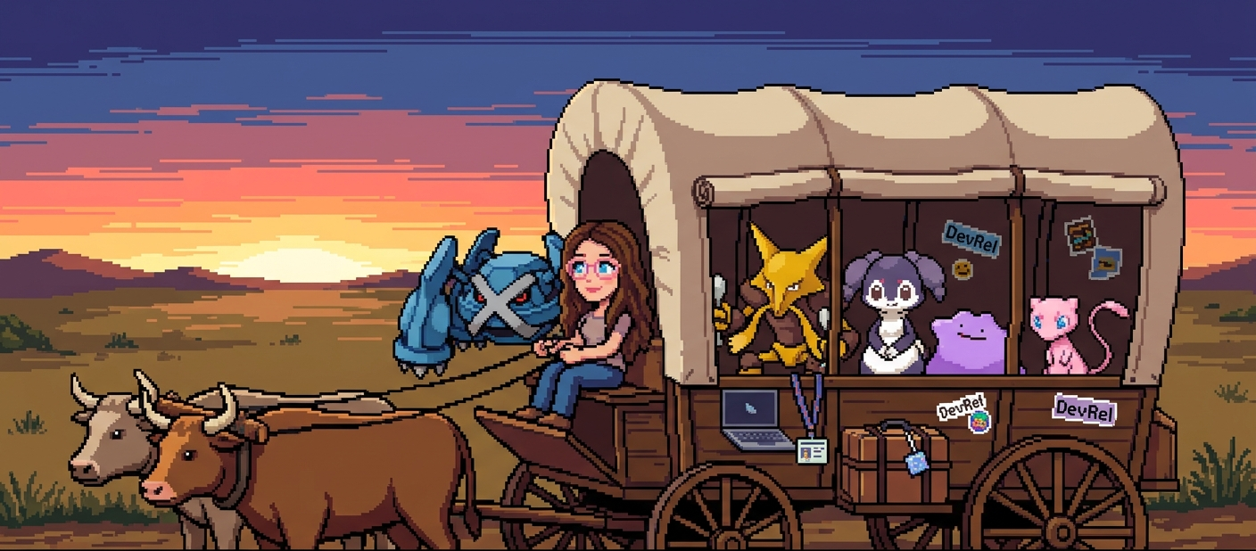
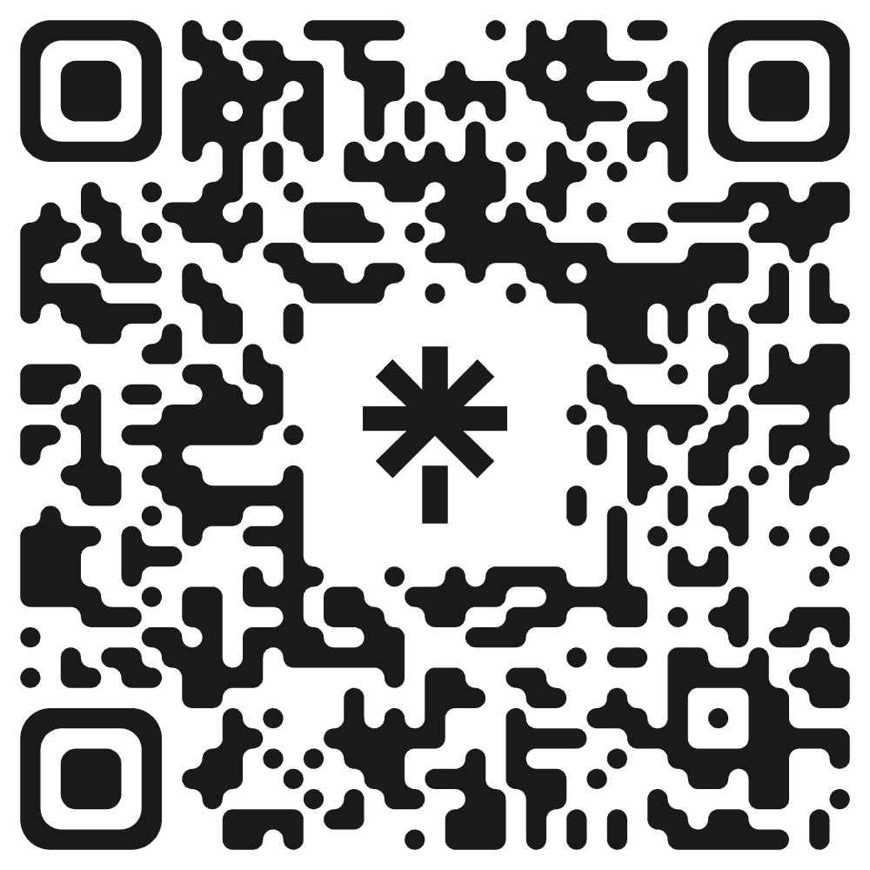
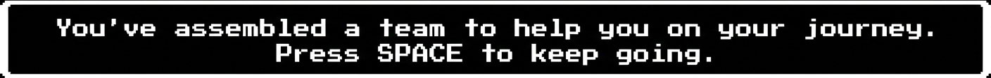
Notes:
Me and my team are moving to the next frontier – I hope you’ll follow along with me
Here’s a link tree with:
My website, how to connect with me
Resources mentioned throughout this presentation
I’ll add these slides to my website as well ☺

